Slide 1
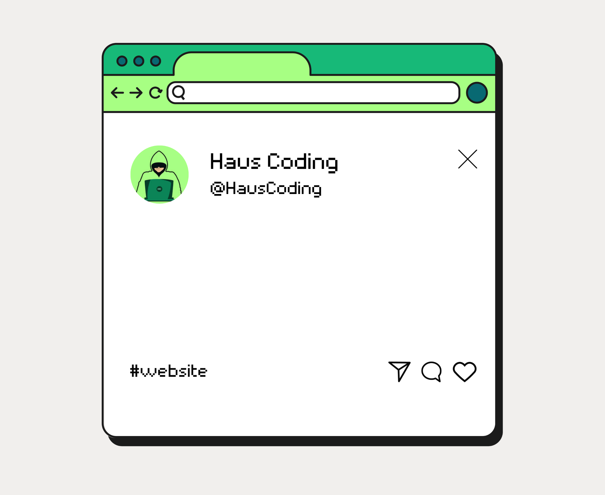
Tutorial membuat website:
Wedding Invitation
Part 3 – Navbar

